Slide 1
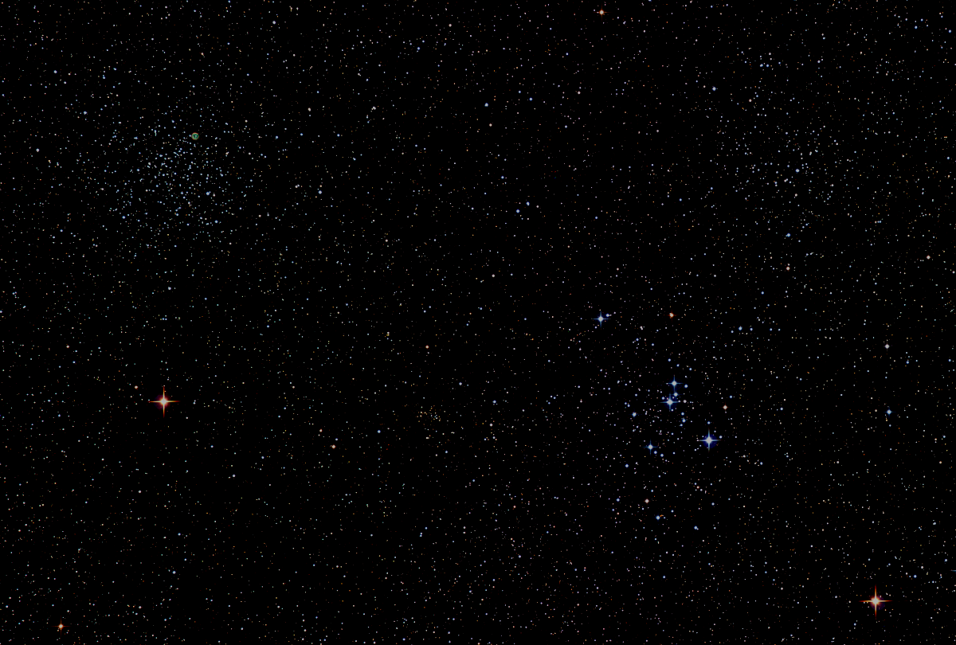

Howard
Astronomical
League
18
September 20th, 2018
Notes:
Howard Astronomical League, June 21, 2018

Slide 2
Introductions

Slide 3
HAL Business Bylaws Amendments
A dissolution clause is required to continue HAL’s non-profit tax exempt status
Adopt “Lifetime Membership” as a new class of membership to recognize exceptional support to HAL
Bylaw amendments must be adopted by members at a general meeting
A quorum (ten members) must be present
2/3 majority passes the resolution

Slide 4
Dissolution Clause
Upon termination or dissolution of the Howard Astronomical League, any assets lawfully available for distribution shall be distributed to one (1) or more qualifying organizations described in Section 501(c)(3) of the Internal Revenue Code of 1986 (or described in any corresponding provision of any successor statute) which organization or organizations have a charitable purpose which, at least generally, includes a purpose similar to the terminating or dissolving corporation.

Slide 5
New Membership Class
Lifetime Membership – These memberships are approved by the board as an expression of the organization’s gratitude for exemplary service and support. They are not subject to annual dues and they have full voting privileges. This type of membership may be applied as a lifetime individual membership or as a lifetime family membership on a case-by-case basis.

Slide 6
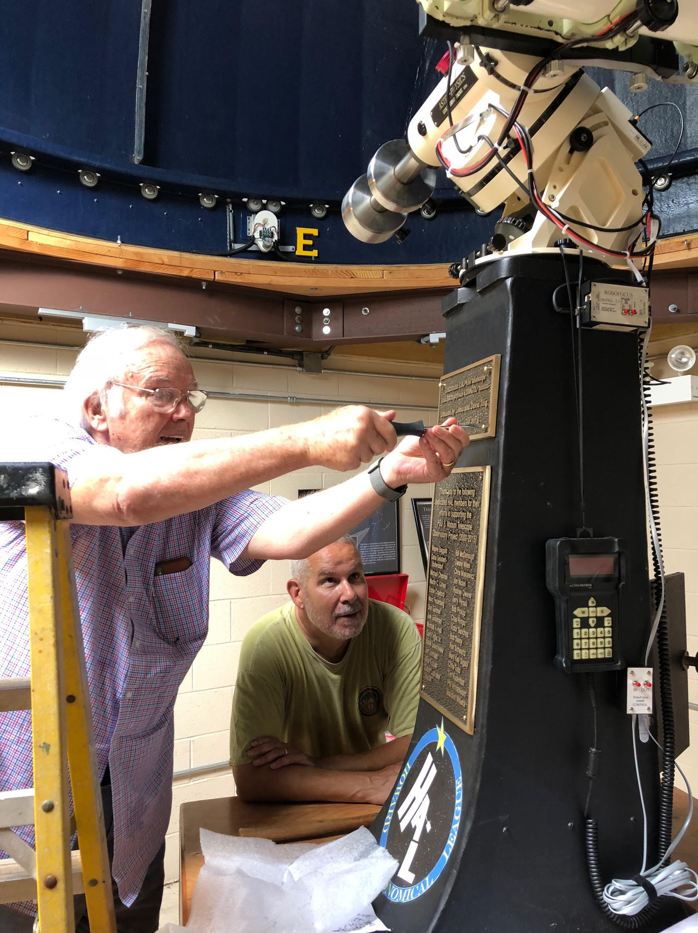
Lifetime Membership Award
Leona and David Illig
For significant donations of equipment, time, and expertise that materially improved the suitability of the Howard Astronomical League Observatory for public outreach and for member use of the observatory
Thank you very much!!

Slide 7
Observatory Report Director: Joel Goodman
Progress:
Updated HALO Policies and Procedures
Pointing issue resolved
Ready to continue conversion of existing CTOs
Present:
Resolving residual dome/scope synch issues
Updating training materials
Beginning to recruit/train new CTOs
Plan:
Make observatory available to members via a CTO training track

Slide 8
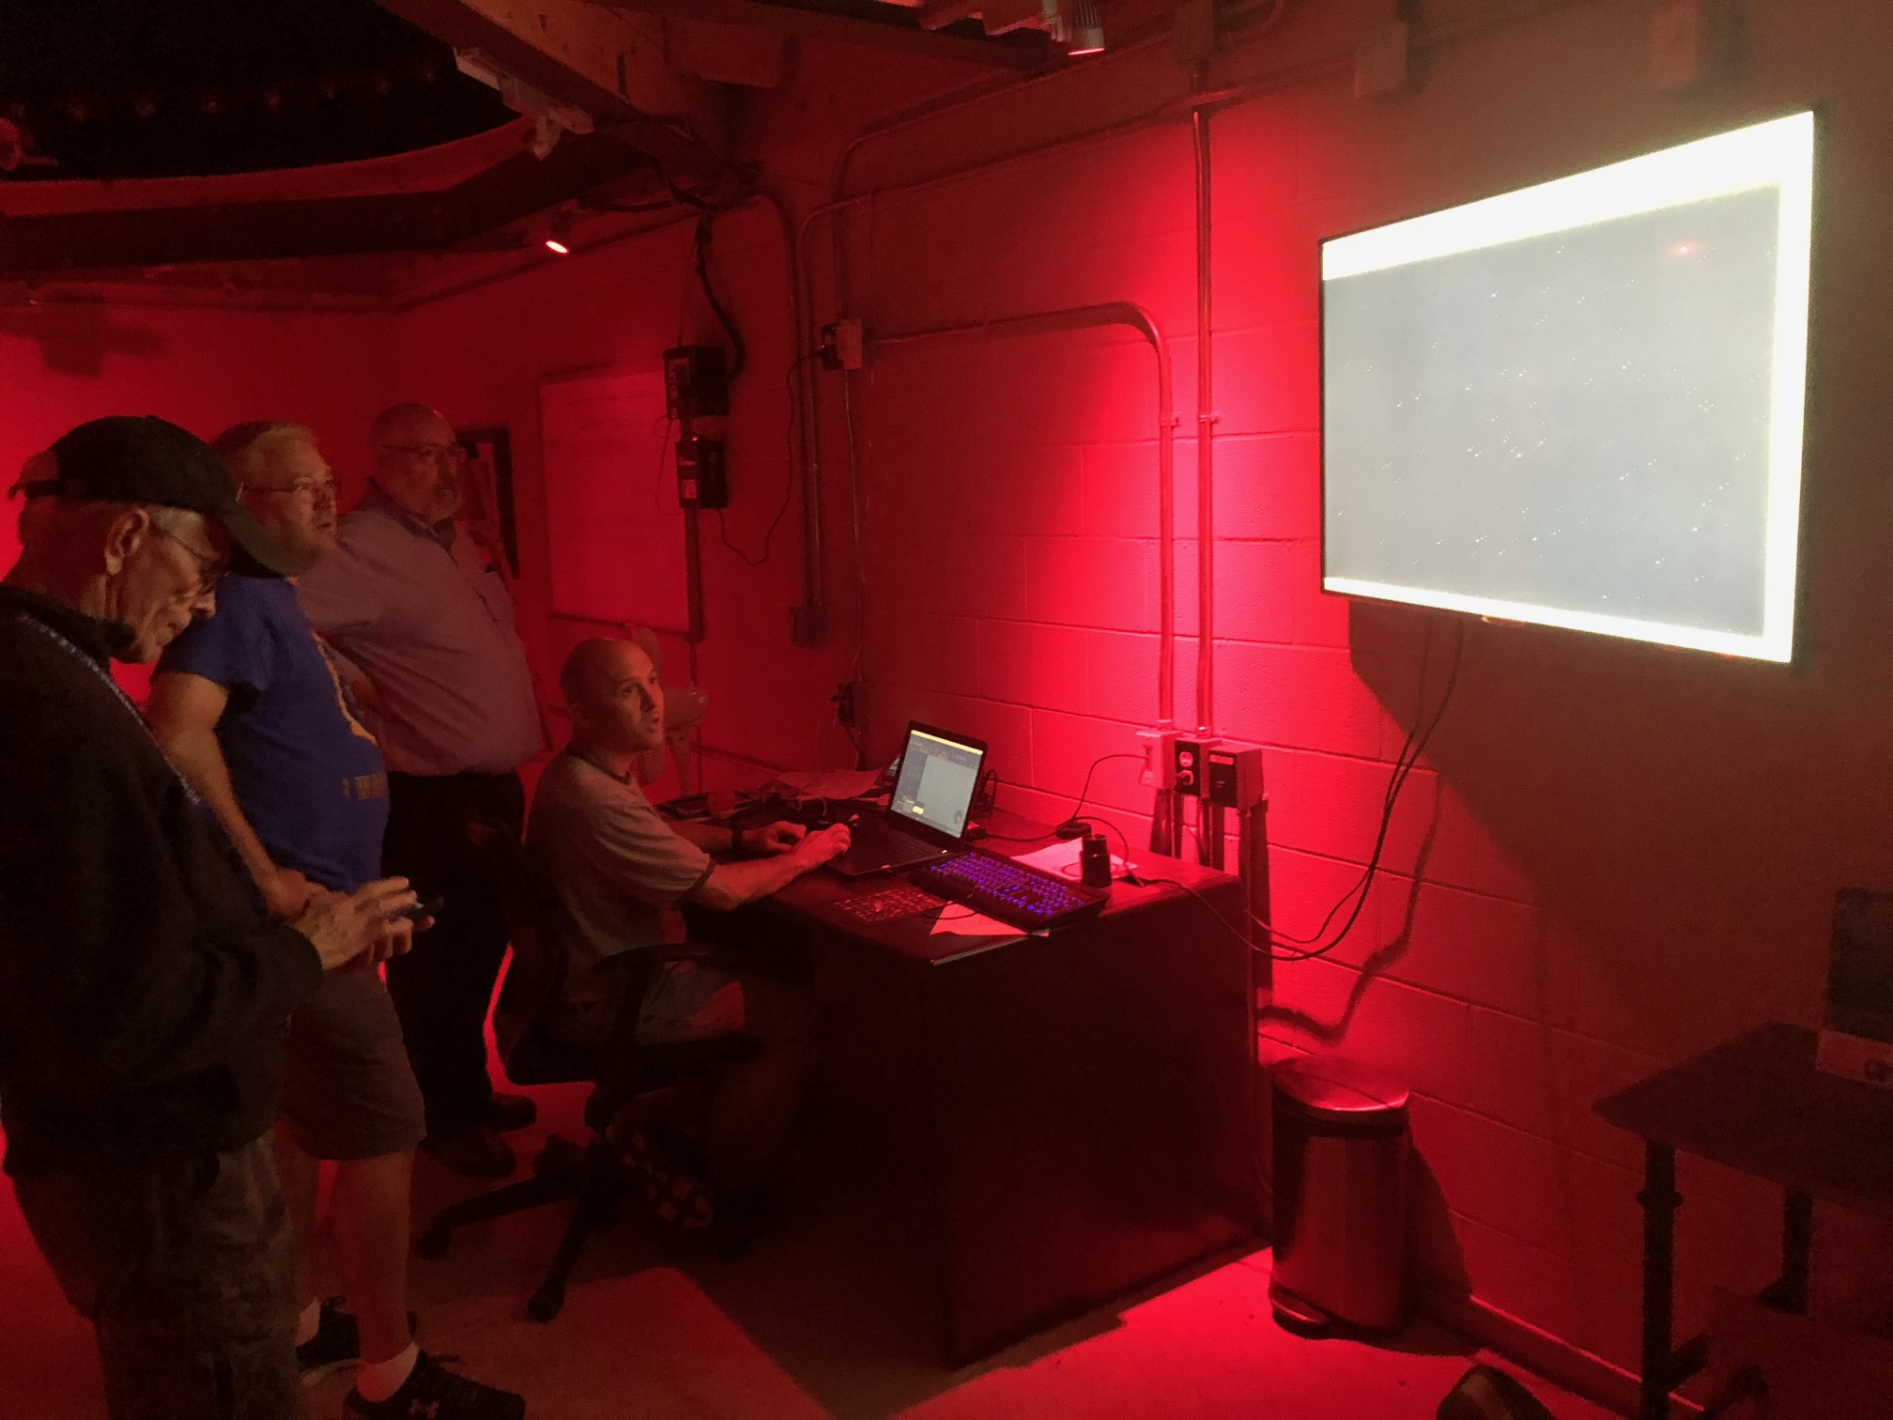
Public Star Party
September 15, 2018
HALO/Illig Scope
Mike Krauss
David Stein
Phil Whitebloom
Eddie Crawford

Slide 9
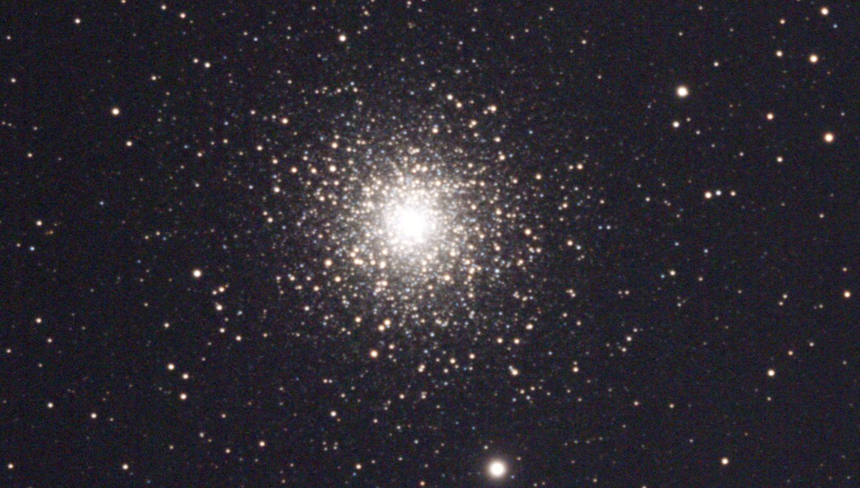

Slide 10
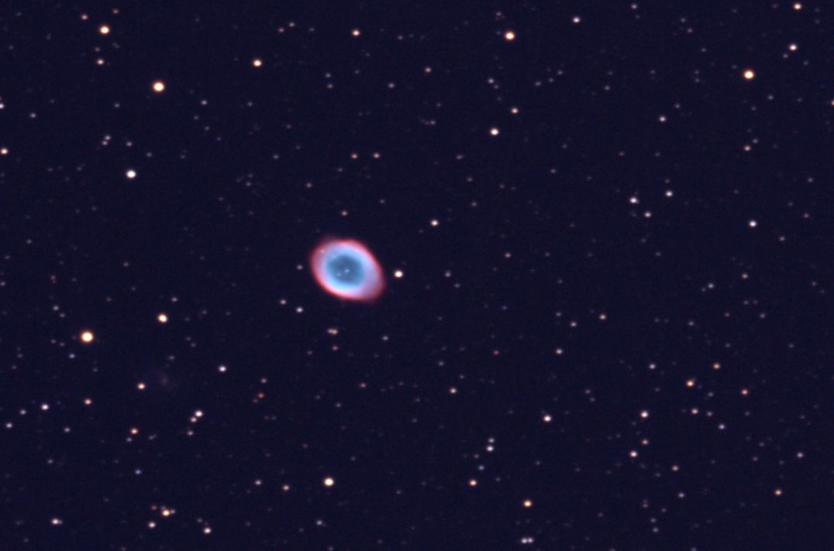

Slide 11
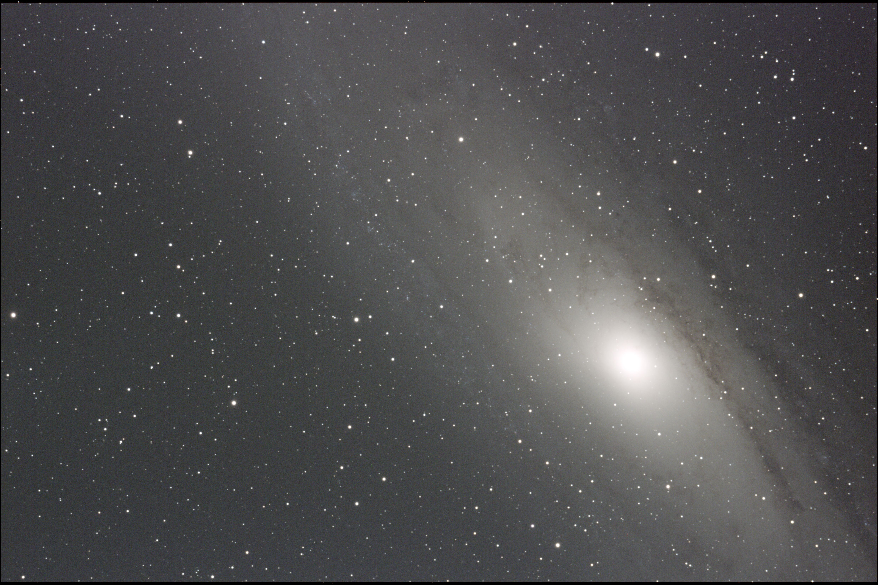

Slide 12
Exoplanet Exploration Committee
Chair: Chuck Cynamon
Establish an Exoplanetary Exploratory Committee with Chuck Cynamon as Chair for the purpose of coordinating HAL activities related to assessing member interest, generating member interest, and developing possible technical solutions for establishing a photometry capability in the HAL Observatory. There will be no implementation authority vested in the committee, and the committee will be charged with periodically reporting progress and providing recommendations to the HAL Board.

Slide 13
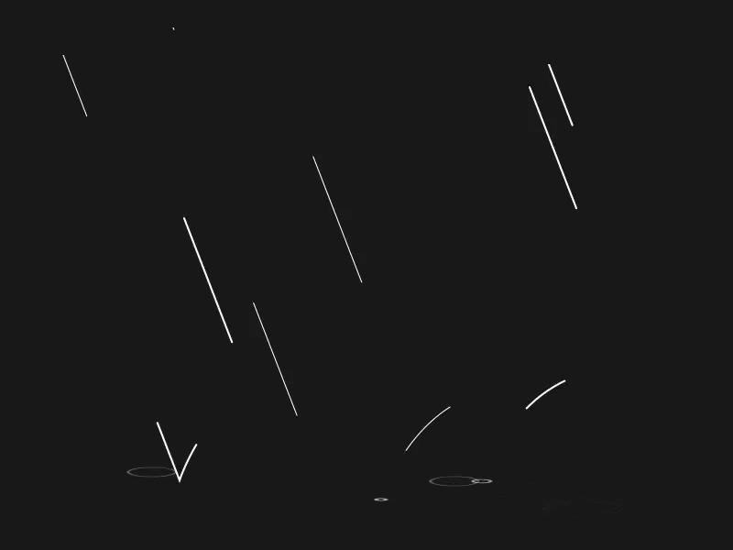
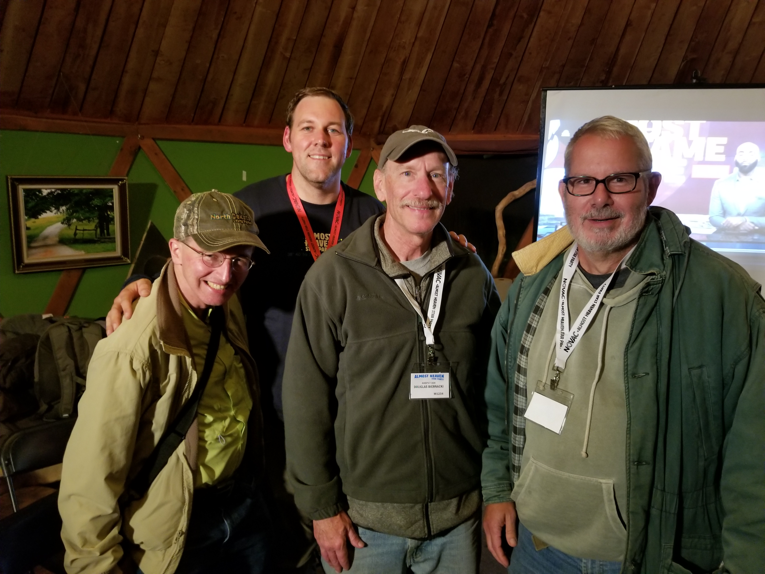
Regional Star Party Reports
Almost Heaven
JoAnn and Stan Shapiro
James Stack (AHSP staff)
Alan Solomon
Doug Biernacki
Jim Johnson
Black Forest
Paul and Amy Montanaro

Slide 14
Upcoming Events
HAL Events – Alpha Ridge Park
October 6th at 6:45 – Members Star Party
October 20th at 6:30 – Public Star Party
Other Events
October 8th to 14th – Chaos Fall Star Party Staunton River State Park, Scottsburg, VA

Slide 15
Comet 46P/Wirtanen 2018 Apparition
Closest Approach: Dec 16th
- 10th closest in modern times
- Visible most of the night
- Passing through Taurus between Hyades and Pleiades
- 0.0775 AU (30 Lunar distances)

Slide 16
Comet 46P/Wirtanen 2018 Apparition
Historically active comet
Predicted magnitude varies by model:
Yoshida – 3
JPL Horizons – 8
Minor Planet Center – 9 to 10
Current observations track with MPC

Slide 17
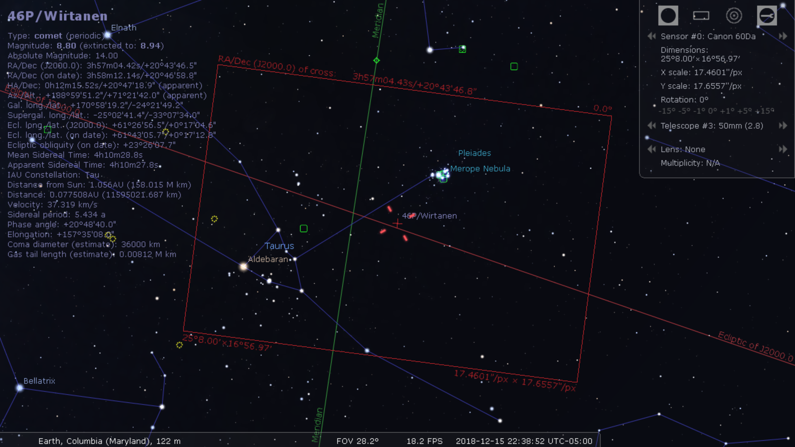
Comet 46P/Wirtanen 2018 Apparition

Slide 18
This Evening’s Speaker
John Stansberry
Solar System Lead, Space Telescope Science Center
Kuiper Belt Objects
Notes:
It is my distinct pleasure to introduce Dr. Bindu Rani. She has been a Postdoctoral Fellow at NASA/Goddard Space Flight Center since July 2016, and will continue to hold that post until June 2019. She was also a Postdoctoral Fellow at the Max-Planck-Institut für Radioastronomie Bonn, Germany from February 2014 to June 2016. She has held visiting scientist and researcher positions at the Korean Very Long Baseline Interferometry Network of the Korea Astronomy and Space Science Institute, and The Gra-dig-nan Bordeaux Nuclear Research Center in France. Dr. Rani has experience in Gamma-ray, X-ray, optical, and radio astronomy. Her optical observational experience includes use of the 1.04 meter telescope at AIRES, Na-in-i-tal, India, and the 1.20 meter telescope at Mount Abu, India.
Among her many achievements, Dr. Rani was awarded the Otto Hahn Medal for outstanding scientific achievements by the Max Planck Society in 2015. She holds Bachelor and Master of Science degrees from University of Delhi and Da-yan-and University, respectively, in India. Last, and certainly not least, Dr. Rani completed her Ph.D at Max-Planck-Institut für Radioastronomie and University of Köln, both in Germany in 2013.

Slide 19
Member Astrophotos and Sketches

Slide 21
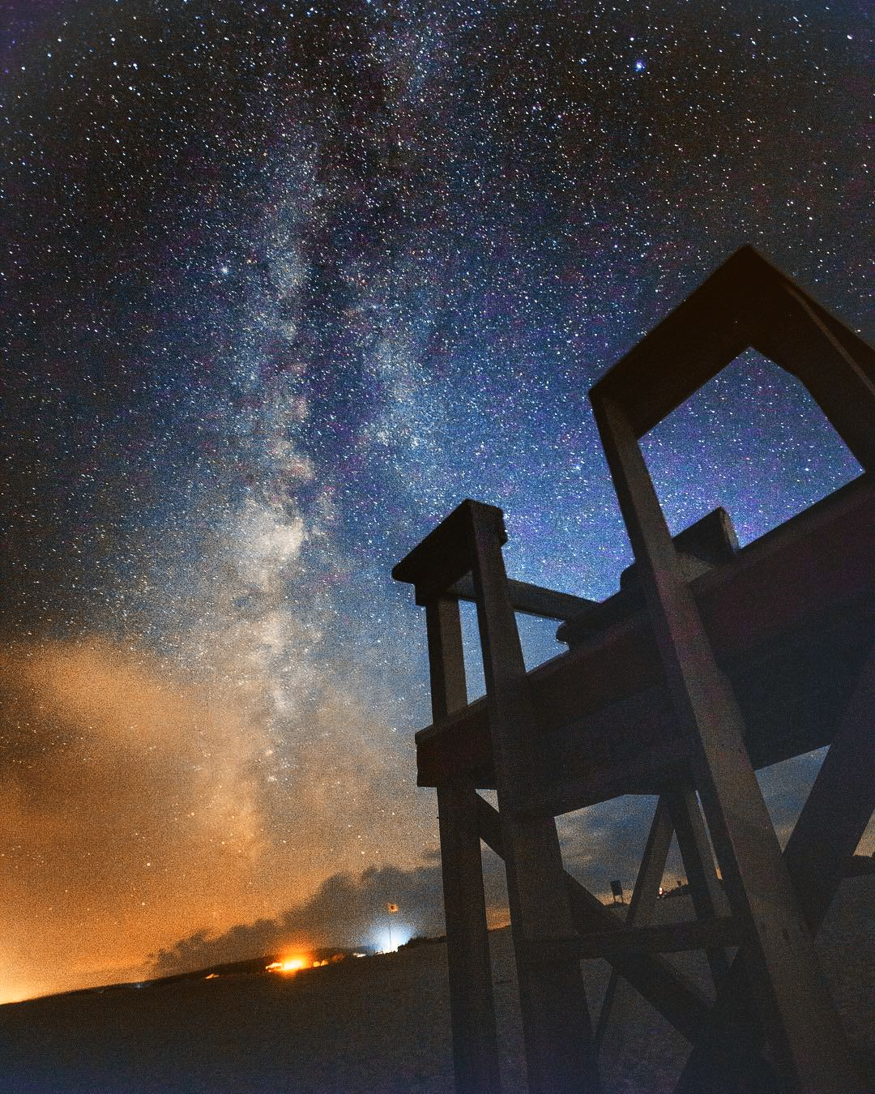

Slide 22
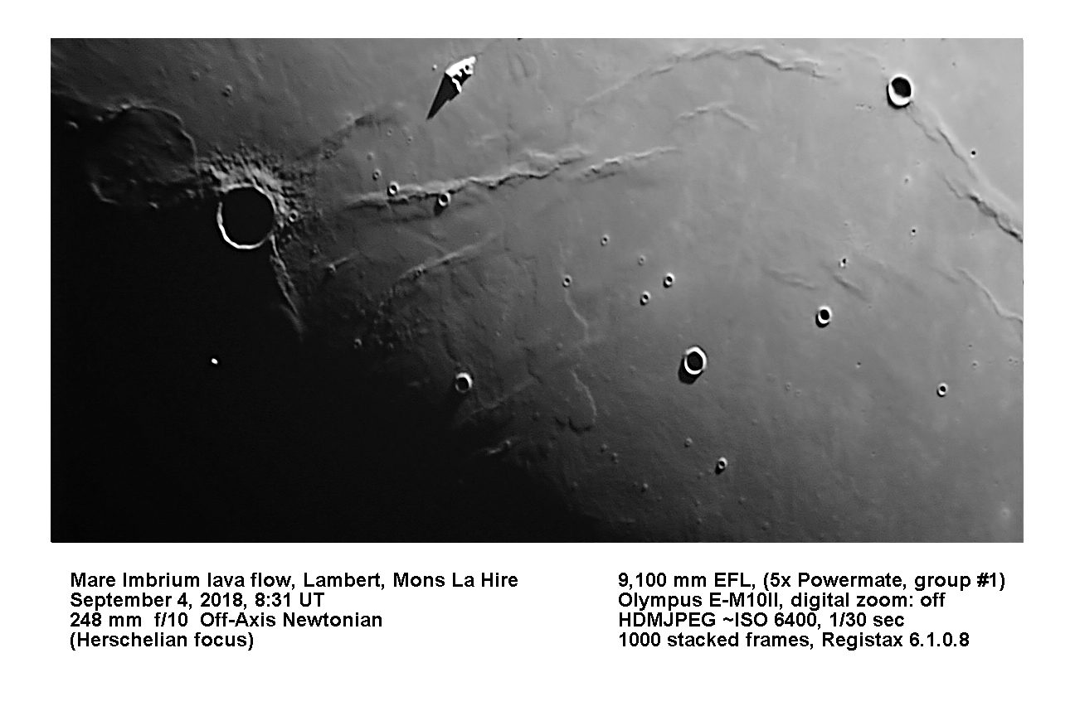
Gary Frishkorn

Slide 23
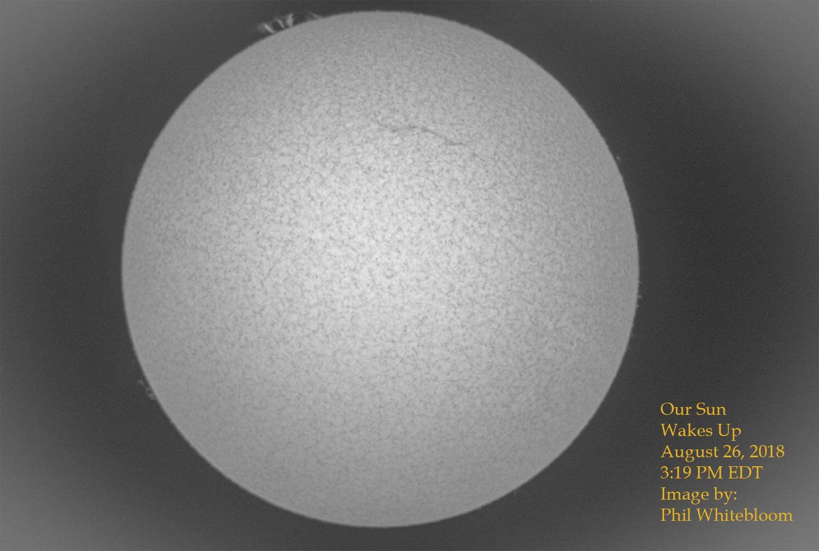

Slide 24
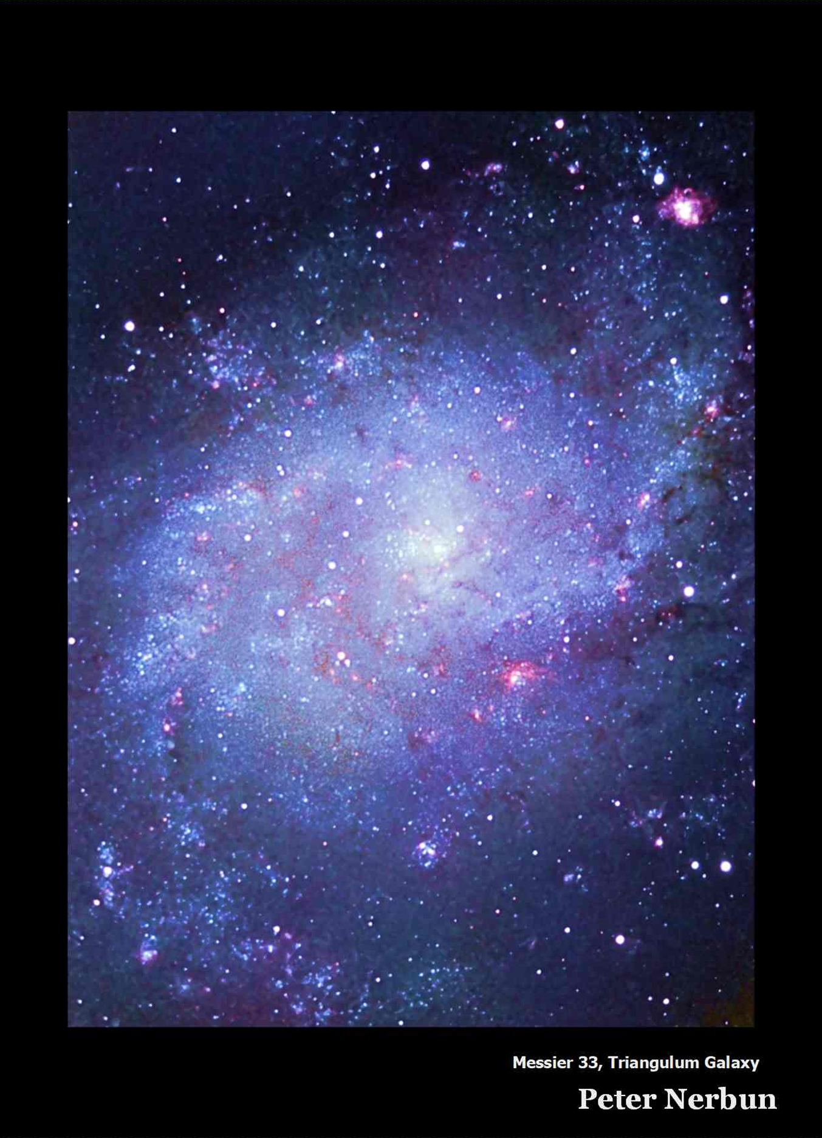

Slide 25
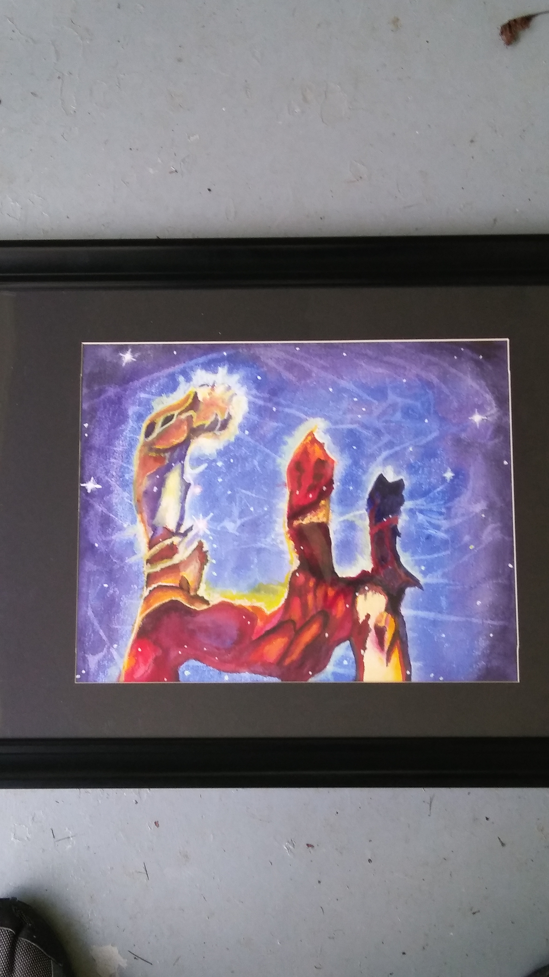

Slide 26
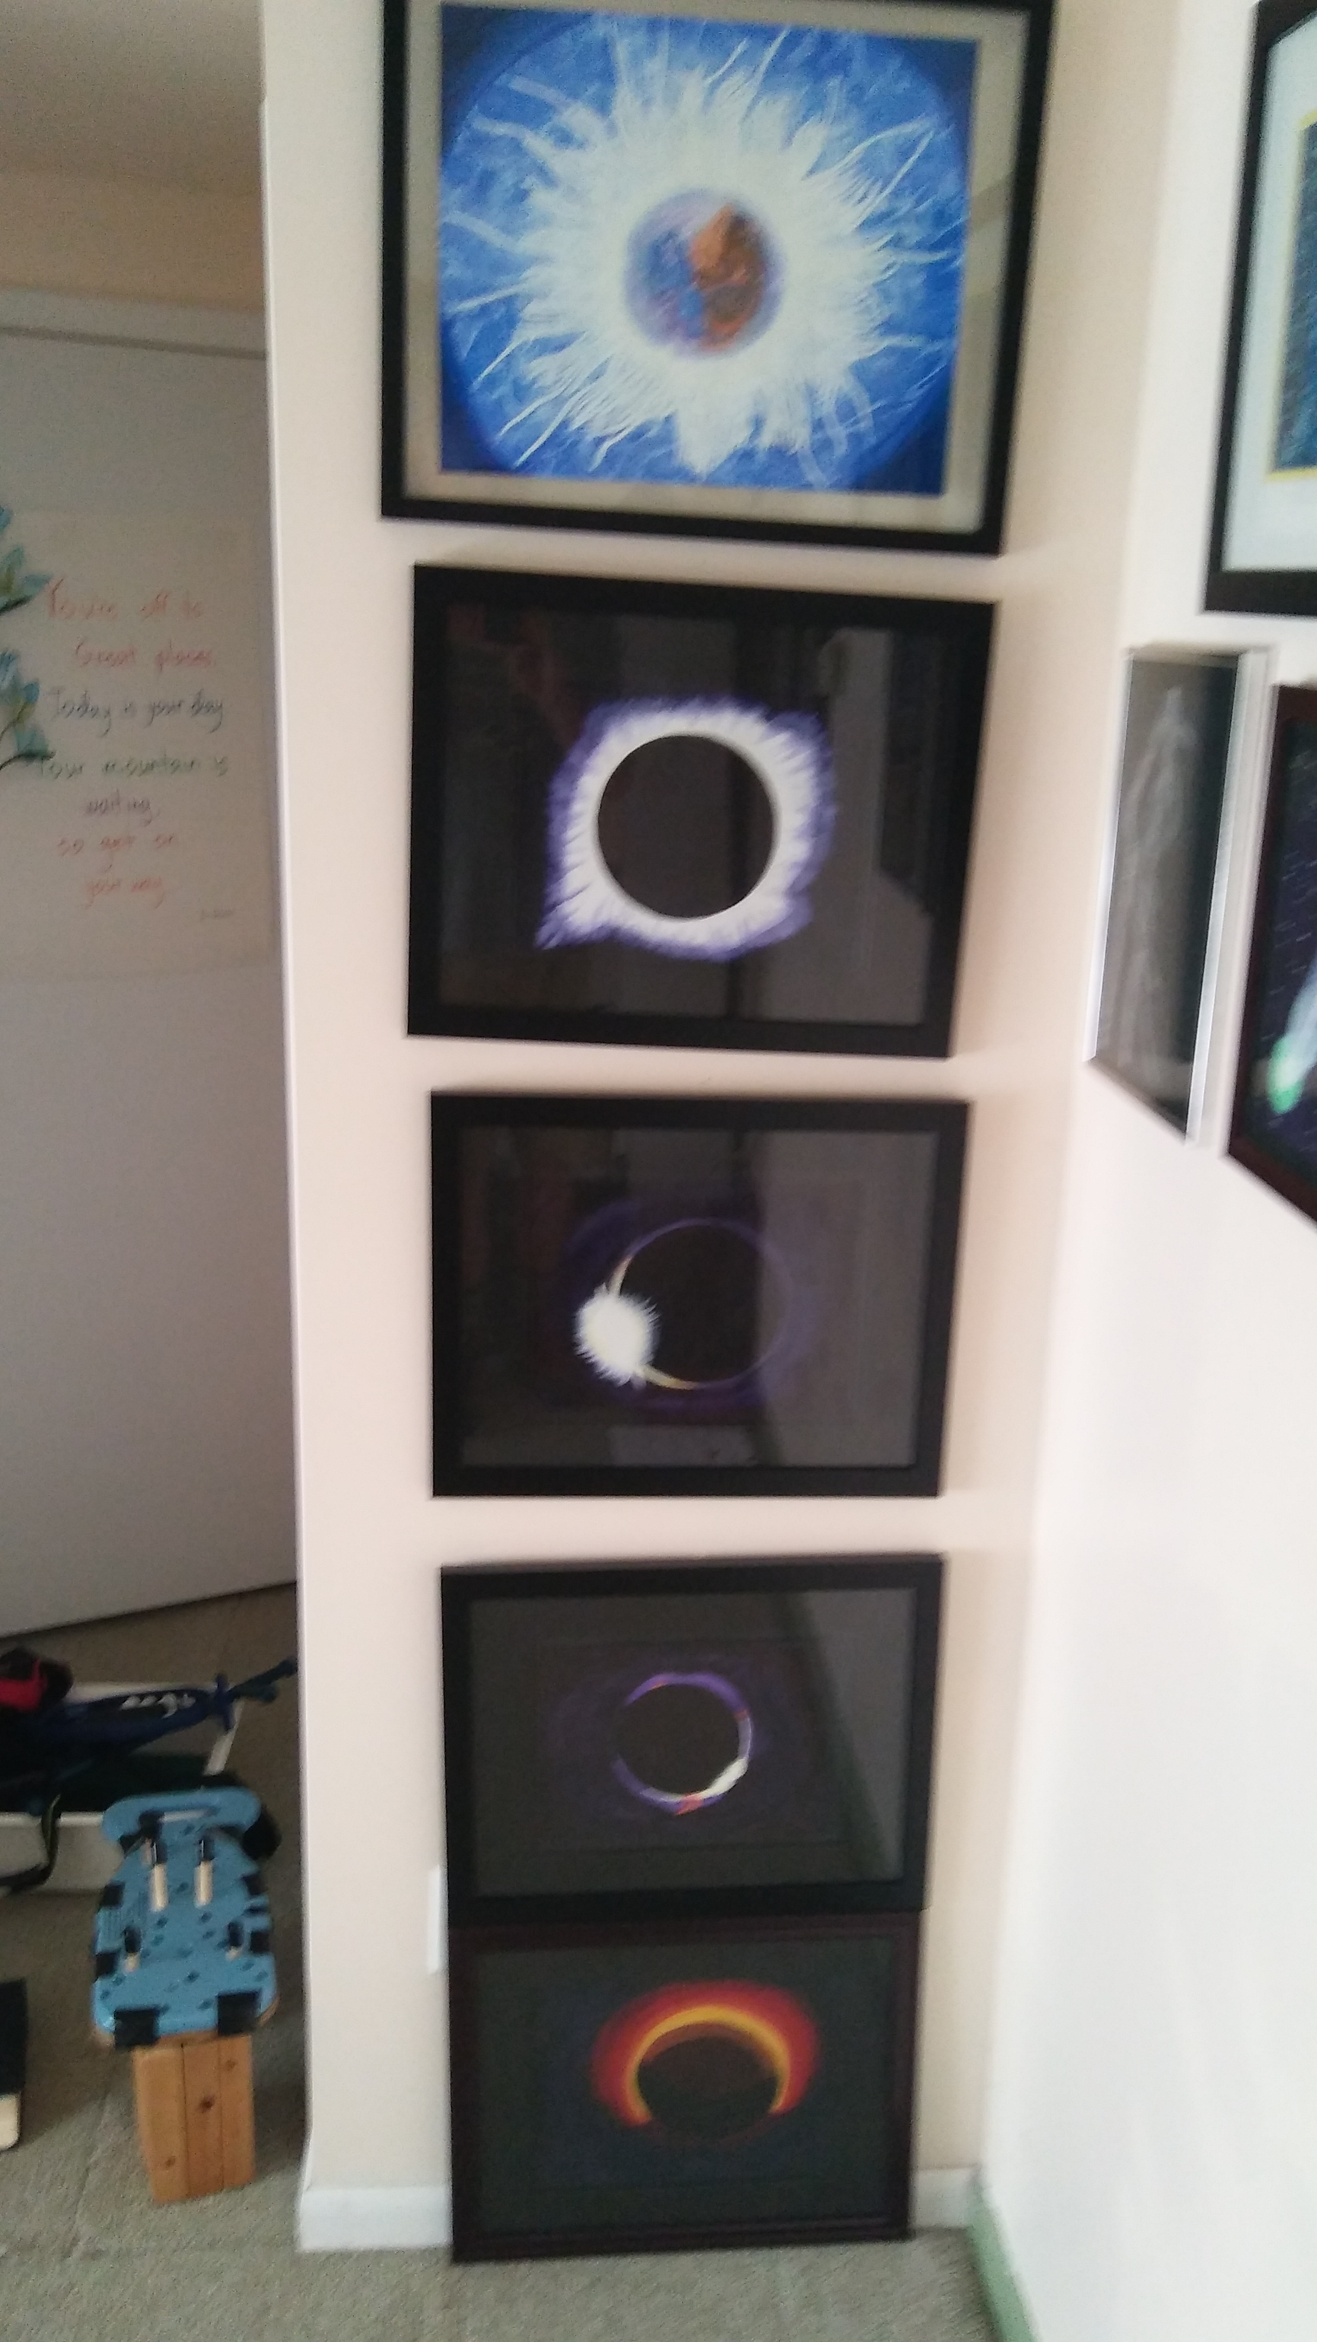

Slide 27
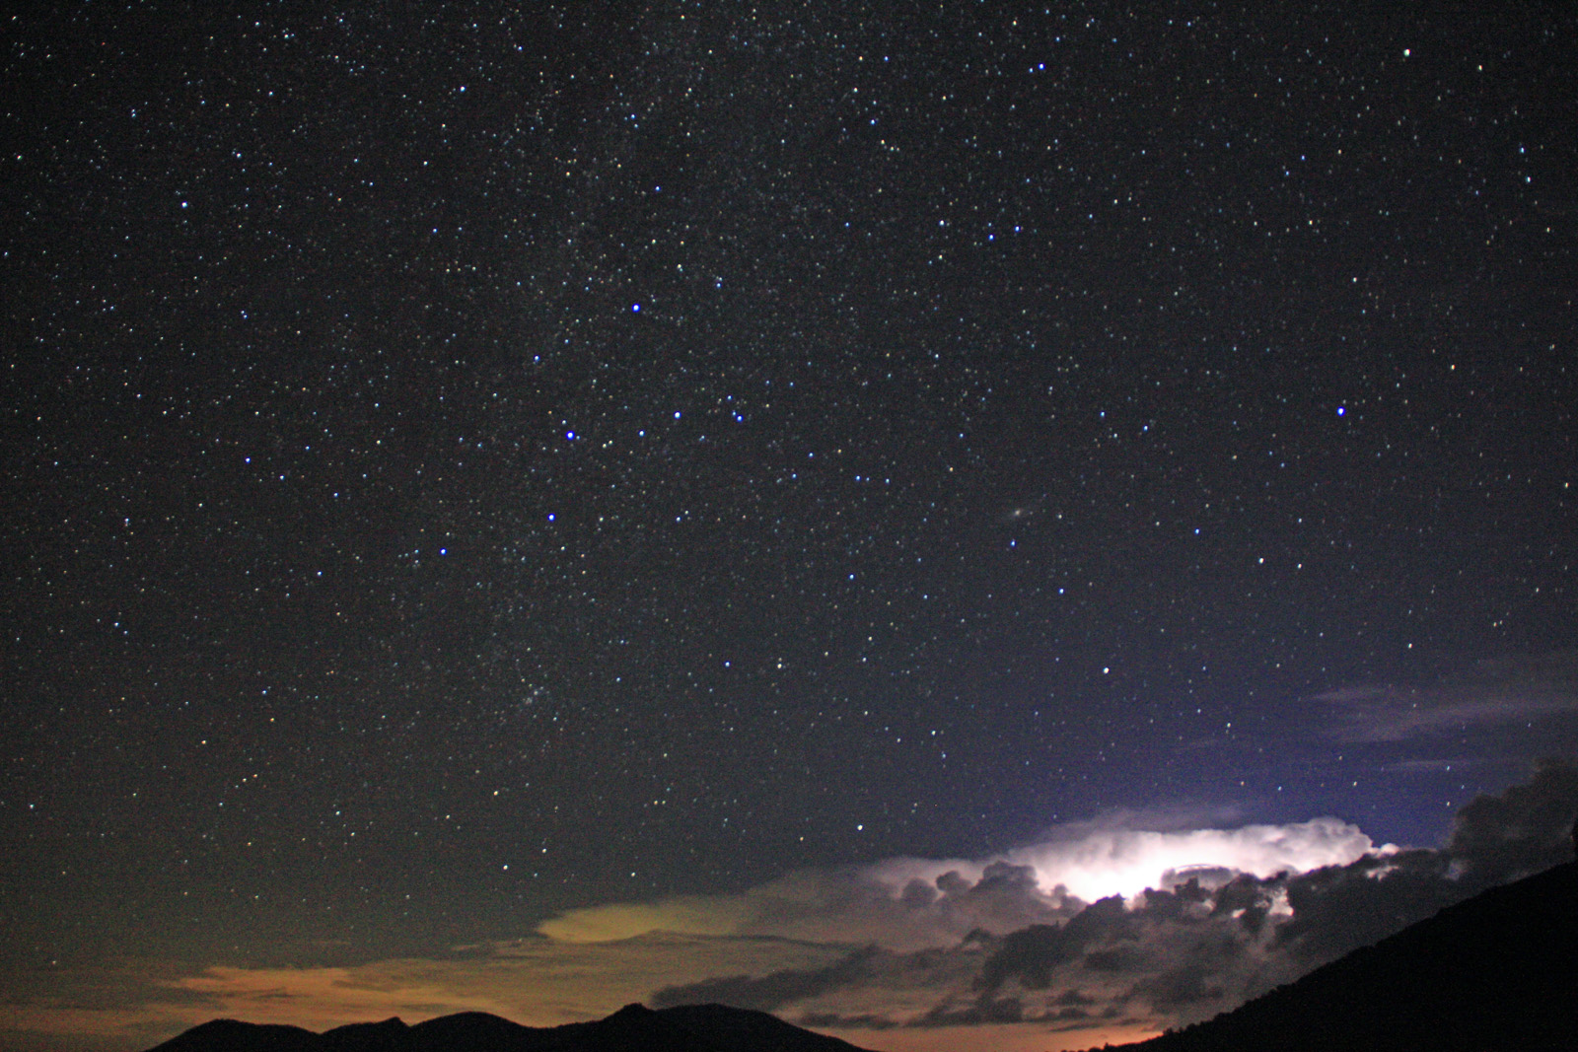
Ken Everhart

Slide 28
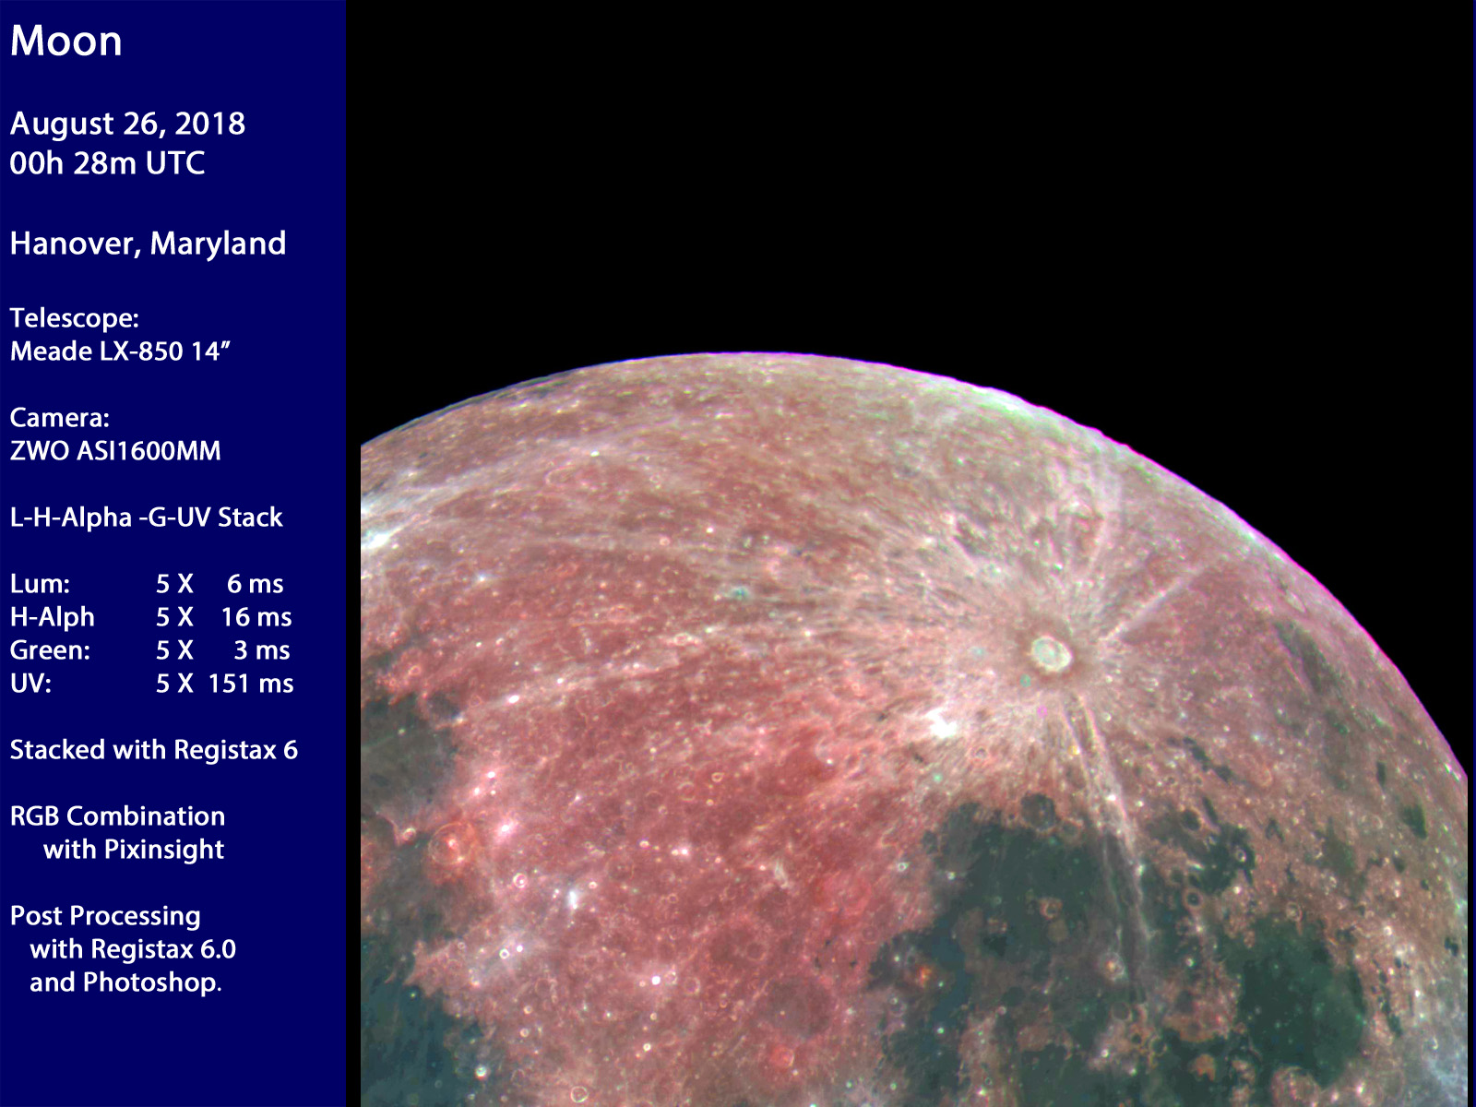
Ken Everhart

Slide 29
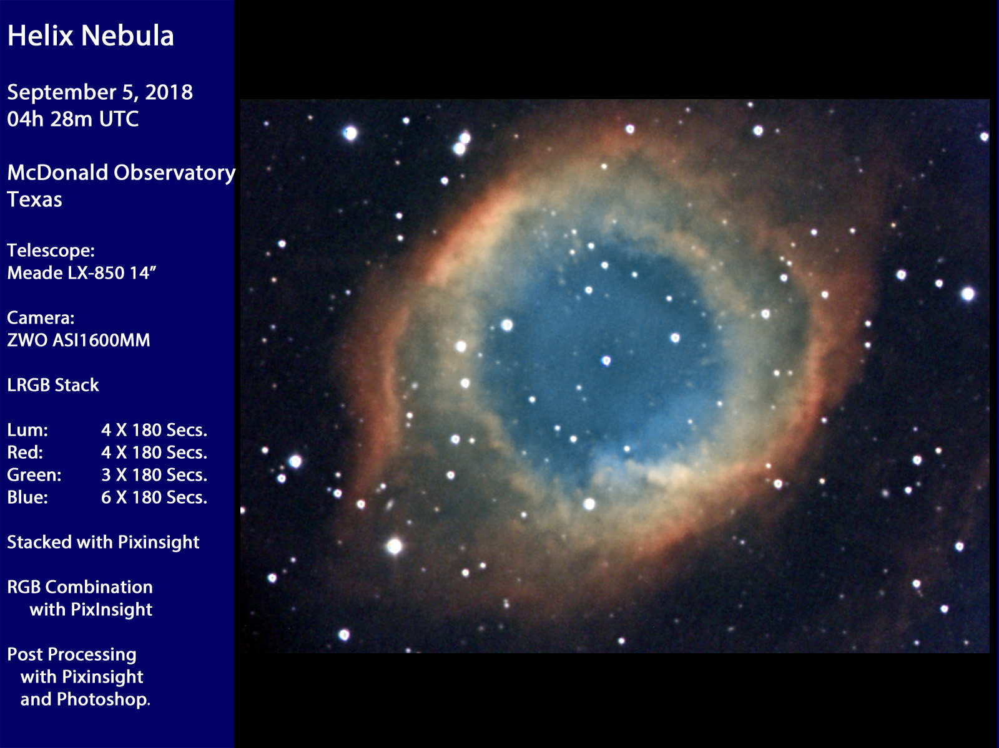
Ken Everhart

Slide 30
Thank You!
Next month’s meeting is on Thursday, October 18th 2018 at 7 PM
Surprise Guest
A Lifelong Journey in Astronomy

